Slide 1
Symbol Table
Symbol table is used widely in many applications.
  dictionary is a kind of symbol table
  data dictionary is database management
In general, the following operations are performed on a symbol table
  determine if a particular name is in the table
  retrieve the attribute of that name
  modify the attributes of that name
  insert a new name and its attributes
  delete a name and its attributes

Slide 2
Symbol Table (Cont.)
Popular operations on a symbol table include search, insertion, and deletion
A technique called hashing can provide a good performance for search, insert, and delete.
Instead of using comparisons to perform search, hashing relies on a formula called the hash function.
Hashing can be divided into static hashing and dynamic hashing

Slide 3
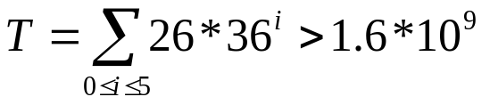
Static Hashing
Identifiers are stored in a fixed-size table called hash table.
The address of location of an identifier, x, is obtained by computing some arithmetic function h(x).
The memory available to maintain the symbol table (hash table) is assumed to be sequential.
The hash table consists of b buckets and each bucket contains s records.
h(x) maps the set of possible identifiers onto the integers 0 through b-1.
If the identifier is 6 alpha-numerical long, with the first one being a letter. Then, the total of distinct identifiers are

Slide 4
Hash Tables
Definition: The identifier density of a hash table is the ratio n/T, where n is the number of identifiers in the table and T is the total number of possible identifiers. The loading density or loading factor of a hash table is α= n/(sb).

Slide 5
Hash Tables (Cont.)
Two identifiers, I₁, and I₂, are said to be synonyms with respect to h if h(I₁) = h(I₂).
An overflow occurs when a new identifier i is mapped or hashed by h into a full bucket.
A collision occurs when two non-identical identifiers are hashed into the same bucket.
If the bucket size is 1, collisions and overflows occur at the same time.

Slide 6
Example 8.1
Slot 1
Slot 2
0
A
A2
If no overflow occur, the time required for hashing depends only on the time required to compute the hash function h.
1
2
3
D
4
5
6
GA
G
Large number of collisions and overflows!
25

Slide 7
Hash Function
A hash function, h, transforms an identifier, x, into a bucket address in the hash table.
Ideally, the hashing function should be both easy to compute and results in very few collisions.
Also because the size of the identifier space, T, is usually several orders of magnitude larger than the number of buckets, b, and s is small, overflows necessarily occur. Hence, a mechanism to handle overflow is needed.

Slide 8
Hash Function (Cont.)
Generally, a hash function should not have bias on the use of the hash table.
A uniform hash function supports that a random x has an equal chance of hashing into any of the b buckets

Slide 9
Mid-Square
Mid-Square function, h_{m}, is computed by squaring the identifier and then using an appropriate number of bits from the middle of the square to obtain the bucket address.
Since the middle bits of the square usually depend on all the characters in the identifier, different identifiers are expected to result in different hash addresses with high probability.

Slide 10
Division
Another simple hash function is using the modulo (%) operator.
An identifier x is divided by some number M and the remainder is used as the hash address for x.
The bucket addresses are in the range of 0 through M-1.
If M is a power of 2, then h_{D}(x) depends only on the least significant bits of x.

Slide 11
Division (Cont.)
Program in which many variables are permutations of each other would again result in a biased use of the table and hence result in many collisions.
To avoid the above problem, M needs to be a prime number. Then, the only factors of M are M and 1. (M>20)

Slide 12
Folding
The identifier x is partitioned into several parts, all but the last being of the same length.
All partitions are added together to obtain the hash address for x.
  Shift folding: different partitions are added together to get h(x).
  Folding at the boundaries: identifier is folded at the partition boundaries, and digits falling into the same position are added together to obtain h(x). This is similar to reversing every other partition and then adding.

Slide 13
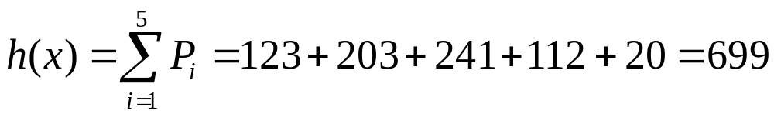
Example 8.2
x=12320324111220 are partitioned into three decimal digits long.
P1 = 123, P2 = 203, P3 = 241, P4 = 112, P5 = 20.
Shift folding:
Folding at the boundaries:
123
203
241
112
20
Folding 1 time
123
203
211
142
Folding 2 times
123
302
h(x) = 123 + 302 + 241 + 211 + 20 = 897
211
241

Slide 14
Digit Analysis
This method is useful when a static file where all the identifiers in the table are known in advance.
Each identifier x is interpreted as a number using some radix r.
The digits of each identifier are examined.
Digits having most skewed distributions are deleted.
Enough digits are deleted so that the number of remaining digits is small enough to give an address in the range of the hash table.

Slide 15
Overflow Handling
There are two ways to handle overflow:
  Open addressing
  Chaining

Slide 16
Open Addressing
Assumes the hash table is an array
The hash table is initialized so that each slot contains the null identifier.
When a new identifier is hashed into a full bucket, find the closest unfilled bucket. This is called linear probing or linear open addressing

Slide 17
Example 8.3
Assume 26-bucket table with one slot per bucket and the following identifiers: GA, D, A, G, L, A2, A1, A3, A4, Z, ZA, E. Let the hash function h(x) = first character of x.
When entering G, G collides with GA and is entered at ht[7] instead of ht[6].
0
A
1
A2
2
A1
3
D
4
A3
5
A4
6
GA
7
G
8
ZA
9
E
25

Slide 18
Open Addressing (Cont.)
When linear open address is used to handle overflows, a hash table search for identifier x proceeds as follows:
  compute h(x)
  examine identifiers at positions ht[h(x)], ht[h(x)+1], …, ht[h(x)+j], in this order until one of the following condition happens:
    ht[h(x)+j]=x; in this case x is found
    ht[h(x)+j] is null; x is not in the table
    We return to the starting position h(x); the table is full and x is not in the table

Slide 19
Rehashing
Another way to control the growth of clusters is to use a series of hash functions h₁, h₂, …, h_{m}. This is called rehashing.
Buckets h_{i}(x), 1 ≤ i ≤ m are examined in that order.

Slide 20
Chaining
We have seen that linear probing perform poorly because the search for an identifier involves comparisons with identifiers that have different hash values.
  e.g., search of ZA involves comparisons with the buckets ht[0] – ht[7] which are not possible of colliding with ZA.
Unnecessary comparisons can be avoided if all the synonyms are put in the same list, where one list per bucket.
As the size of the list is unknown before hand, it is best to use linked chain.
Each chain has a head node. Head nodes are stored sequentially.

Slide 21
Hash Chain Example
ht
0
A4
A3
A1
A2
A
0
1
0
2
0
3
D
0
4
E
0
5
0
6
G
GA
0
7
0
8
0
Average search length is (6*1+3*2+1*3+1*4+1*5)/12 = 2
9
0
10
0
11
L
0
25
ZA
Z
0

